Slide 1
DSC530 Final Project
By
Saima Rahmanzai

Slide 2
Research Questions
Below are some of the research questions I have for my final project:
How do we identify the independent variables that can help predict which types of attacks will be more eminent in the future?
I have four datasets to work with and analyze each one in detail for relationships between incidents/Breach some independent variables such as Types of attacks (Espionage, Corporate Attacks, etc.), increase during time of pandemic, increase in the number of vulnerabilities or types of systems with vulnerabilities, etc. My datasets some have global numbers, and some based in the U.S. Need to figure out if focus on US or Global? Need to really analyze the data to understand it.
If I have the dependent variable in a different dataset and independent variable in a different dataset, do I need to append them in the same dataset or can I continue to do tests on them separately and then predict?
What are the different types of variables and if data needs to be cleaned and types changed, nulls dropped to use it for further analysis?
Is the data accurate and of quality so that the model based on this data is accurate?
What testing approach should I use to analyze my data. What statistical tests to apply to help solve my final project topic?

Slide 3
Currently, I have the following four datasets (plus a combined dataset where I concatenated Dataset2 and Dataset4)
Dataset #1:
File Name: Allitems.csv (By MiTRE.ORG)
Source Description: The CVE List is built by CVE Numbering Authorities (CNAs). Every CVE Record added to the list is assigned and published by a CNA.
Dataset #:2
File Name: cyber operations incidents.csv (By Kaggle)
Source Description: CVS of cyber incidents as reported by the Council of Foreign Relations.
Dataset #:3
File Name: PRC Data Breach Chronology - (By Privacy Rights Clearing House)
Source Description: “As a nonprofit organization protecting privacy for all by empowering individuals and advocating for positive change, we have focused exclusively on consumer privacy rights and issues since 1992. We strive to provide clarity on complex topics by publishing extensive educational materials and helping people find answers to their questions. We also amplify voices often underrepresented in policy discussions in our work championing strong privacy protections.”
Dataset #:4
File Name: Security Incident totals (By Kaggle)
Source Description: Security incident counts and details. This dataset looks at the data security incidents which have been reported to the Information Commissioner’s Office (ICO).
NOTE: For my hypothesis testing in particular to test that incidents increase as time goes on, and that espionage type of incident is on the increase, I merged (concatenated) two datasets (2 and 4) to run additional tests on the combined dataset. The two datasets I concatenated were: Dataset @2: Cyber Operations incidents and Dataset #4: Security incidents.

Slide 4
Problem Statement and Hypotheses:
Problem statement: I would like to analyze the data on breaches and vulnerabilities and evaluate if there truly is a rise in Cyber threats over the years and identify the reasons for the increase. I would like to see the correlation of breaches/incidents (independent Variable) and time (Dependent Variable) and build upon three hypotheses.
Hypotheses:
I would to be able to test the below Hypotheses using the data on Cyber Attacks and vulnerabilities:
As we are more dependent on Technology, there are more system vulnerabilities to address and therefore, hackers take advantage of the non-remediated vulnerabilities. More vulnerabilities, more security incidents and breaches. Vulnerabilities and the Security Incidents that take advantage of these vulnerabilities increase over time.
Majority of the hacking activity is State Sponsored (Espionage) and the attention of nations to gain advantage over other nations has shifted from warfare to bring a nation down by having cyber attacks on our economy (Infrastructure, Corporations) and Military or Government agencies. Most increase in incidents are due to this independent variable.
There maybe a correlation of certain types of systems with most frequent vulnerabilities that need to be hardened. These are allowing opportunities for hackers to exploit them. NOTE: The data I pulled do not have the details to test this hypothesis so I will drop this third hypothesis.

Slide 5
Variables and their brief meanings
I would like to see the correlation of breaches/incidents and vulnerabilities (independent Variable) with time (Year) independent variable to test our hypotheses.
Dependent Variable: Year (in Dataset 1)
Dependent Variable: Year (in the “Combined dataset” by merging Dataset 2, and Dataset4)
Independent Variables:
Name: Shows the vulnerabilities that can be changed into incidents not addressed (Dataset 1)
Count: Computed variable from the vulnerability frequency (Dataset 1)
Incident Type (“Combined Dataset”)
Count: Computed variable of count of security incidents (“Combined Dataset”)
.

Slide 6
Summary of Dataset, Dataframes, Independent and Dependent Variables and Data Types
Dataset Source and brief description | Description of dataset | Final DataFrame (df) Name with Total Rows | Total Variables final df | Independent Variable | Independent Variable Dtype | Possible Dependent Variable | Dependent Variable Dtype
Allitems.csv | Dataset1: CVE® is a list of publicly disclosed cybersecurity vulnerabilities.obtained from mitre.org. Data generated in 2022-01-21. Data is from Jan 1999 to Jan 2022. | allitems (226679 records) | 2 (One was computed) | Year (Computed) | Object | Name/Description of Vulnerability | Object
cyber-operations-incidents.csv | Dataset2: Read the cyber-operations-incidents.csv containing the CVS of cyber incidents from 2005 to 2020, as reported by the Council of Foreign Relations | cyberopsfinal_df (474 records - dropped from 481 after removing Nan records for the independent variable "Year" | 8 (One was computed) | Year (Computed) | Object | Type | Object
Security Incident totals 04.19 - 09.20.csv | Dataset3: Read the Security Incidents file. This dataset looks at the data security incidents which have been reported to the Information ommissioners Office (ICO). | Secincidentfinal_df (50 records. Dropped from 140 after excluding non-Cyber incidents) | 32 (float64(22), int64(3), object(7)) | Year (Computed) | Object | Incident Type | Object
PRC Data Breach Chronology - 1.13.20 .csv | Dataset4: Read the PRC Data Breach Chronology.csv" file. It contains the Security incidents in the US collected by a non-profit. 9015 records. Oldest date of incident January 2005 and the latest October 2019. #No data in 2020. These are all incidents in the US. | PRCBreach_df (9015 records) bit removed non-cyber incidents. New dataset: PRCBreach_final_df (2533 records) | 16 variables (float64(4), int64(1), object(11)) | Year of Breach | Int64 | Type of Breach | Object
Combined Dataset | Concatenated Dataset 2 and Dataset 4. We used this file for detailed analysis | 524 records | Two variables: Year and Type. Later computed two computed numeric variables for Year and Type | Year (Year_int computed variable for some tests) | Object and Int64 | Type (Type_Num computed) | Object and Int64

Slide 7
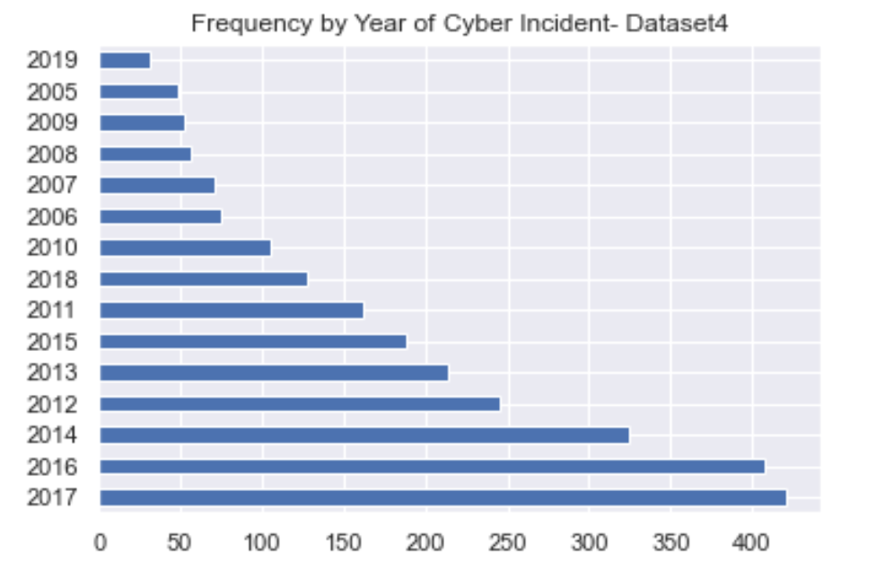
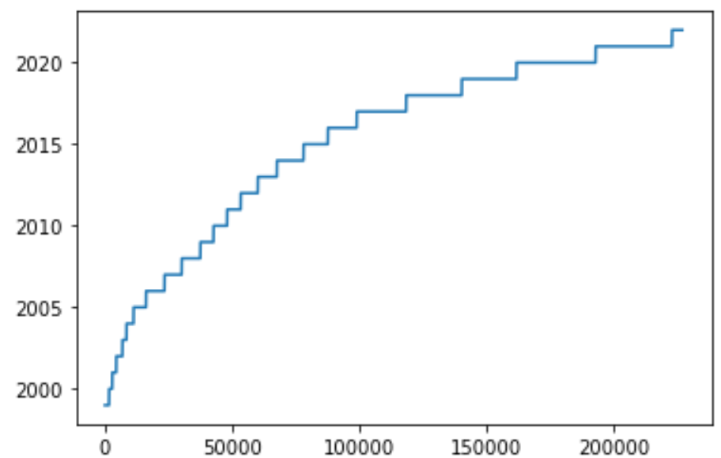
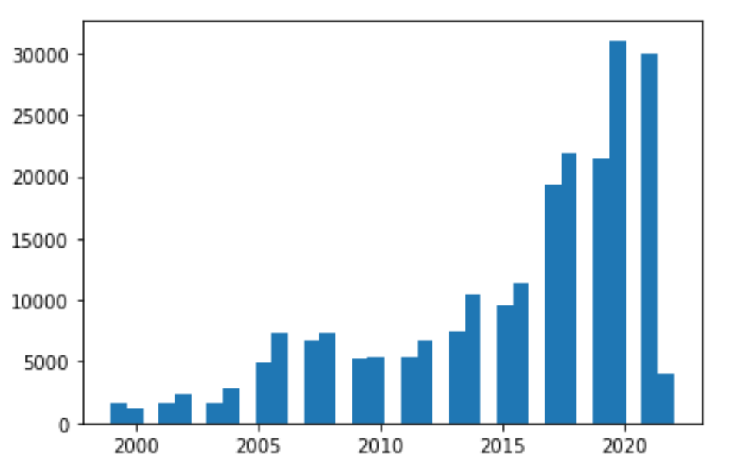
Histograms/Plots for the two Datasets we will be using (Vulnerabilities and Combined Dataset)
Dataset1 (Vulnerabilities): Combined DataSet pf Security Incidents (Dataset 2 and 4):
Visual Analysis/Observations:
Dataset1:
Year of Vulnerability (Independent). Shows vulnerabilities are on the rise year after year (two looks provided)
Dataset2:
Year of Incidents Variable (Independent): This dataset also shows that incidents are on the risk year after year.
Type of Cyber Incident: This chart shows that on an aggregate, Espionage is the most frequent of all incident types by a large margin.
NOTE: I did not include histograms of all four datasets and I just concentrated my testing on these two datasets with the ‘Combined Dataset’ created from Dataset 2 and Dataset 4.

Slide 8
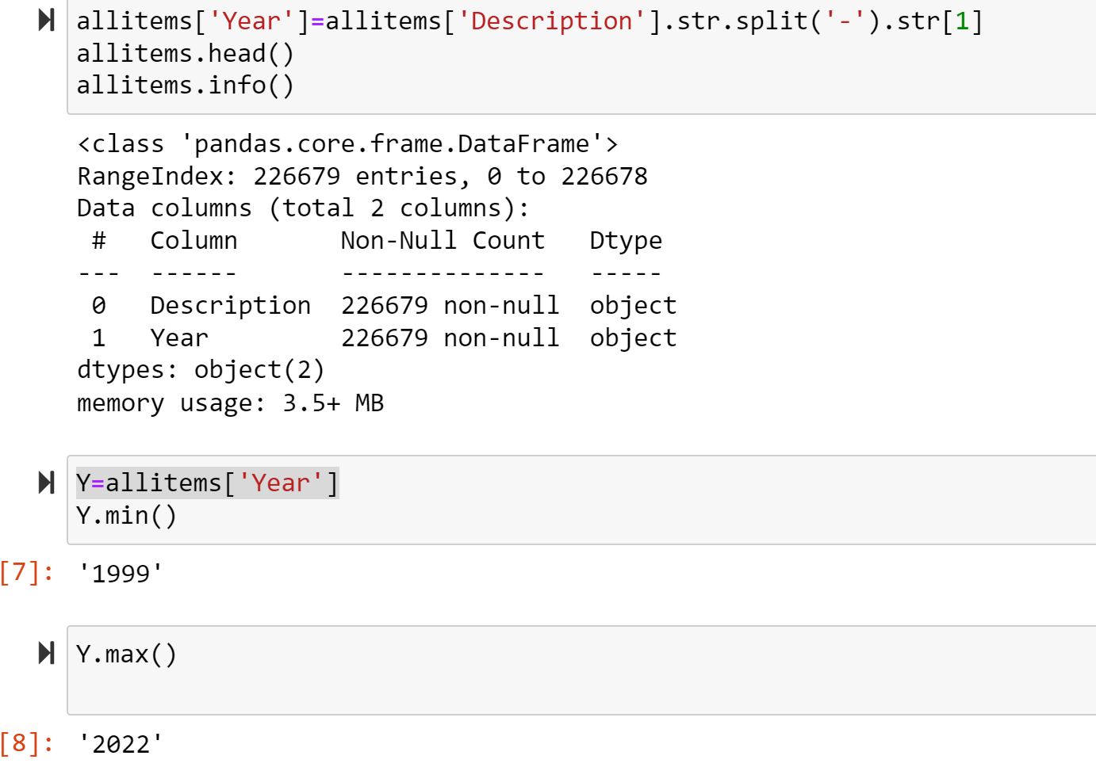
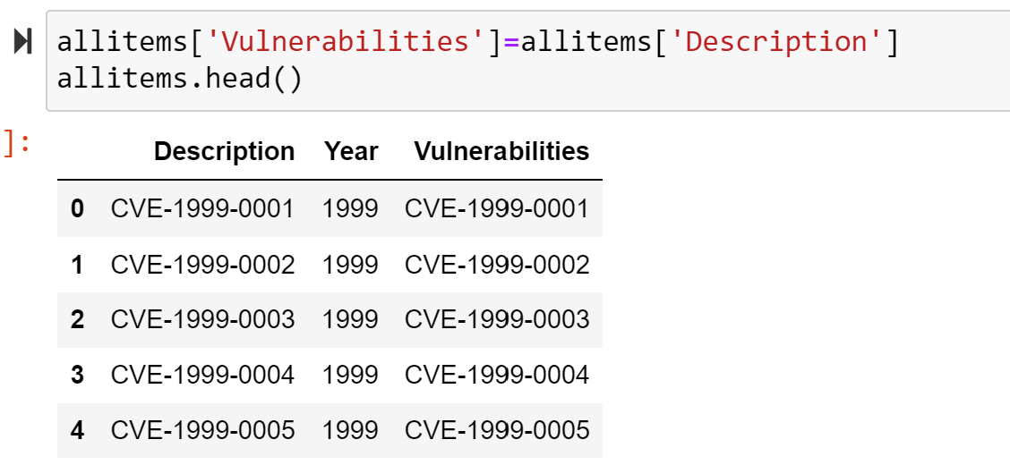
Descriptive characteristics about the variables
Dataset1: Dataset2:
Visual Analysis/Observations:
Dataset1:
There are total of 226,679 records and two variables: Description and Year (computed from Description)
Minimum year value is 1999 and maximum is 2022.

Slide 9
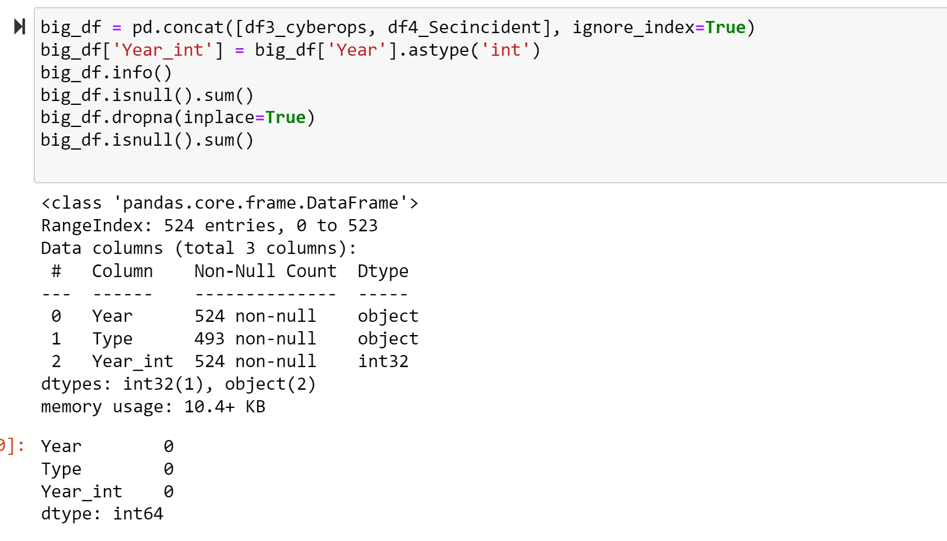
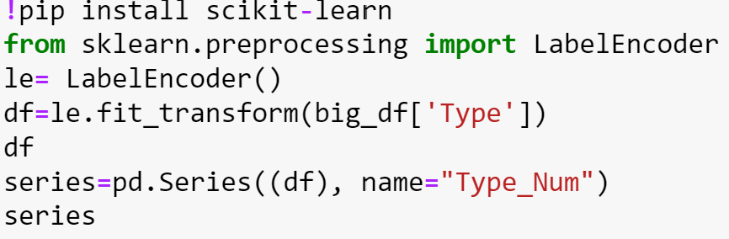
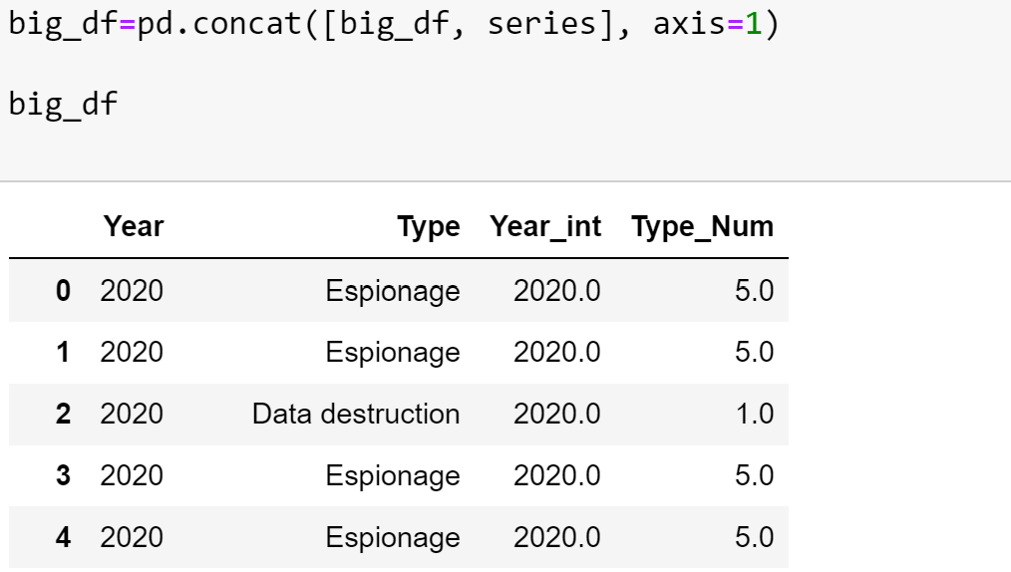
Descriptive characteristics about the variables
Visual Analysis/Observations:
Combined Dataset (result of a merge between Dataset 2 and Dataset 4):
There are total of 524 records and subset dataset has 2 variables (Year and Type) and 2 computed variables (numeric equivalents) as the original variables were objects and not numeric.
Most commands required them to be numeric. I used the scikit-learn library and in particular the LabelEncoder tool to map the non-numeric incident type variable to a numeric number e.g. Espionage is now equal to 5.0, Data destruction Type is mapped to 1.0 etc.

Slide 10
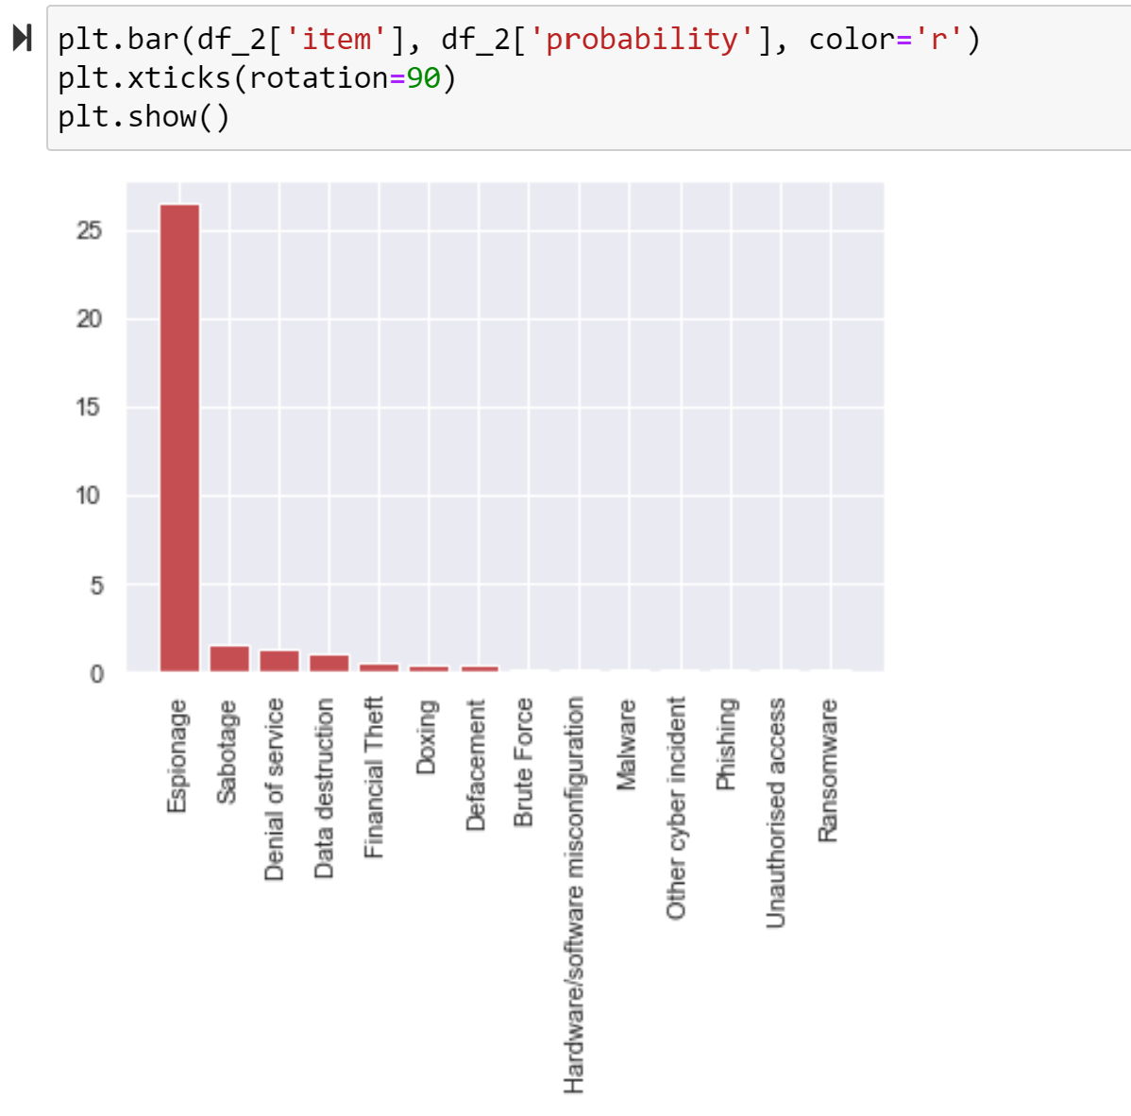
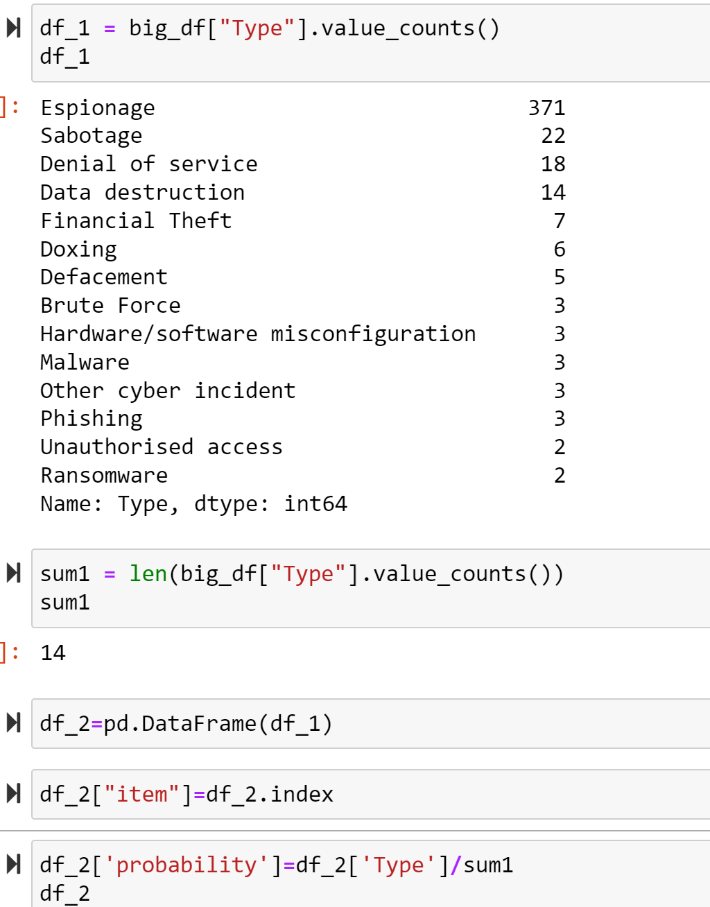
PMF
I used the “Combined Dataset” and calculated PMF for Variable “TYPE”. As shown above, the Type “Espionage” has the highest probability.

Slide 11
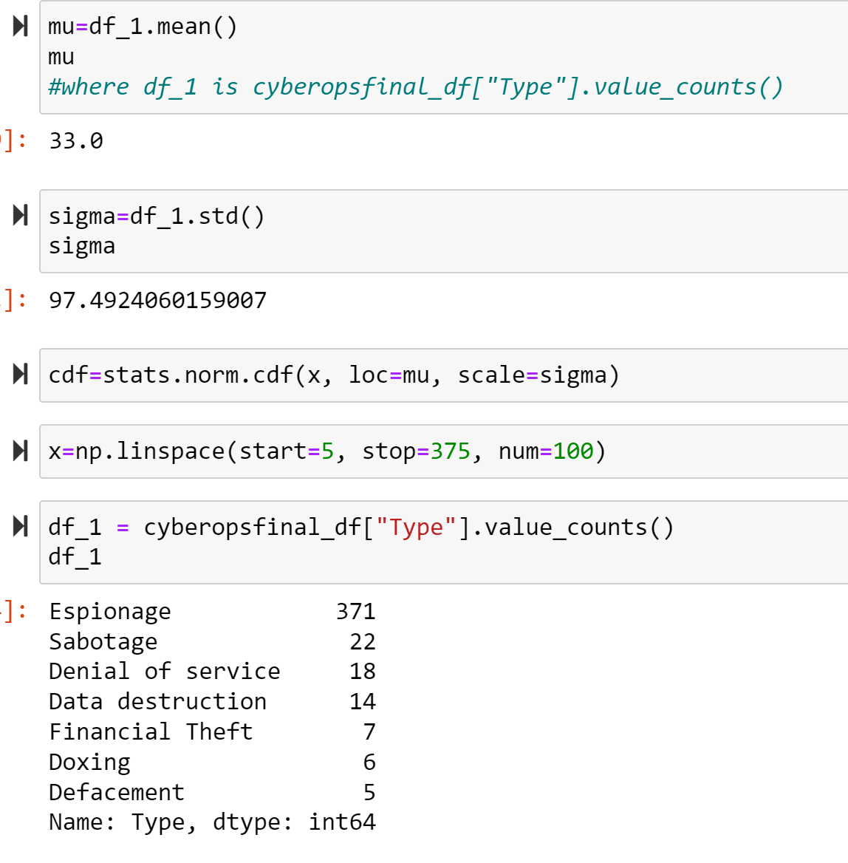
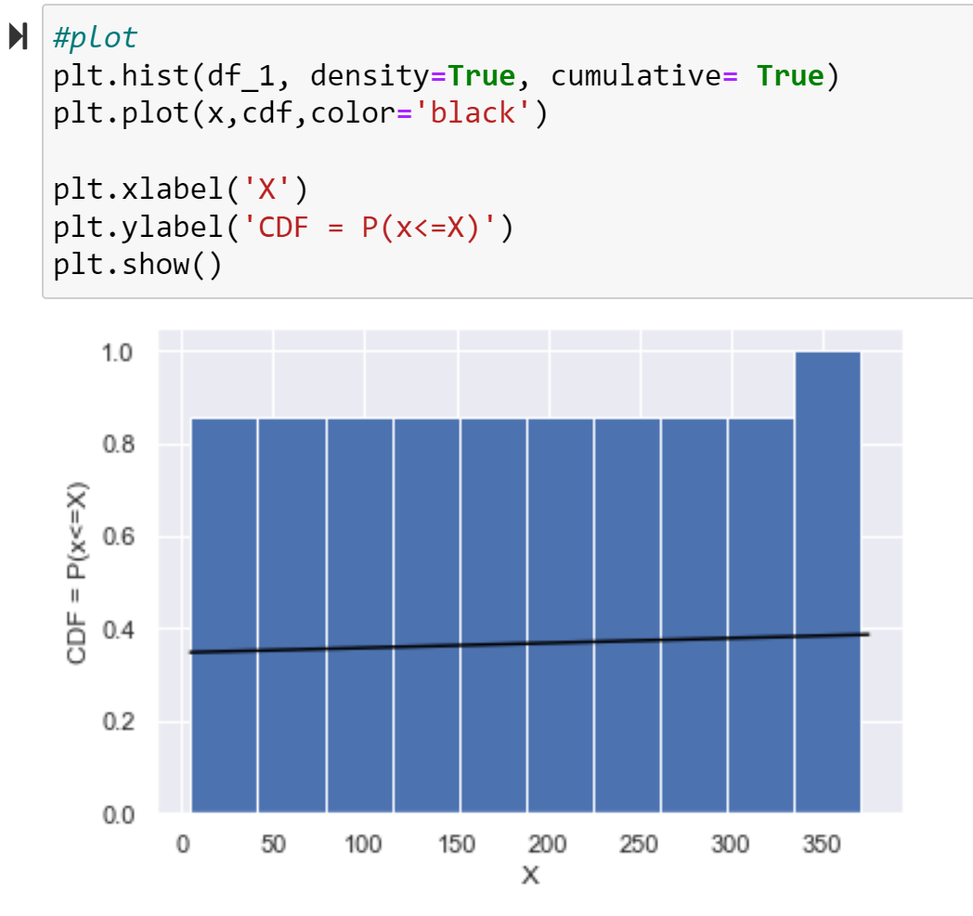
CDF for one of the Variables: I will create a CDF plot for field “Type” in dataframe cyberopsfinal_df. See below:

Slide 12
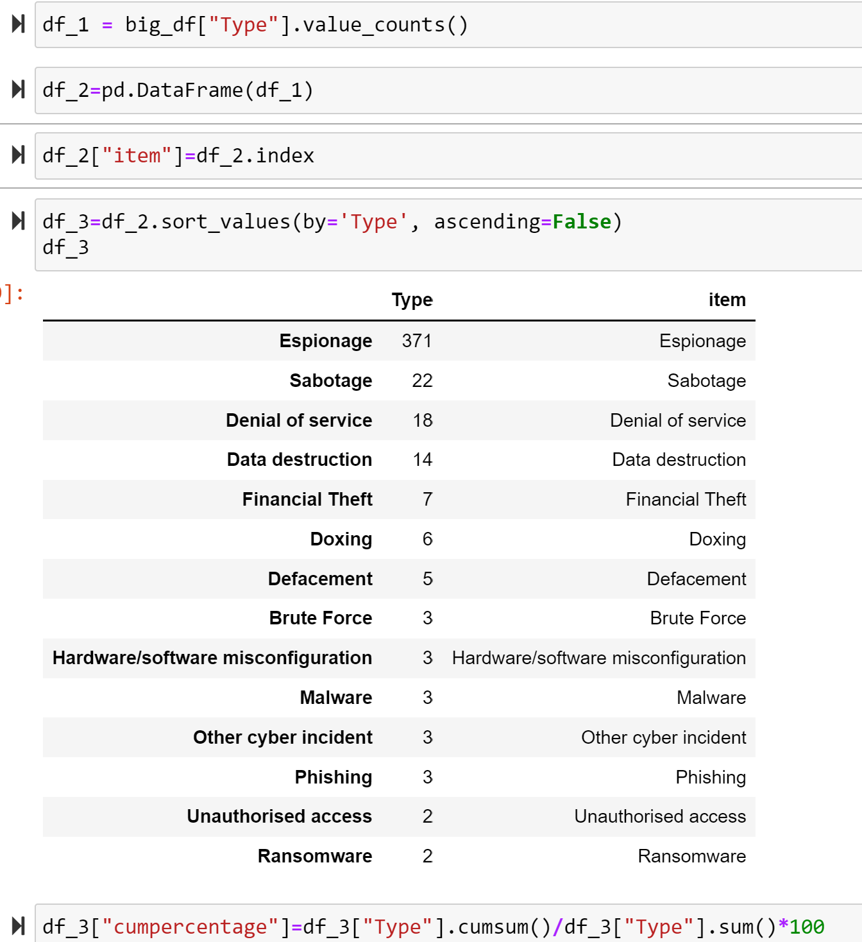
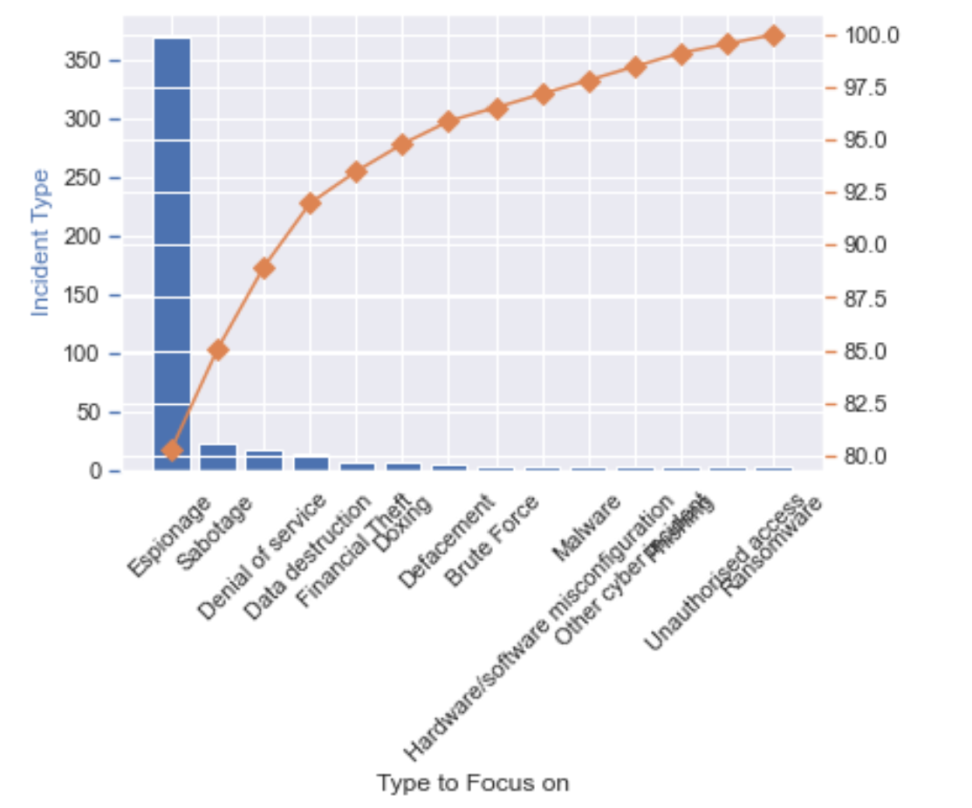
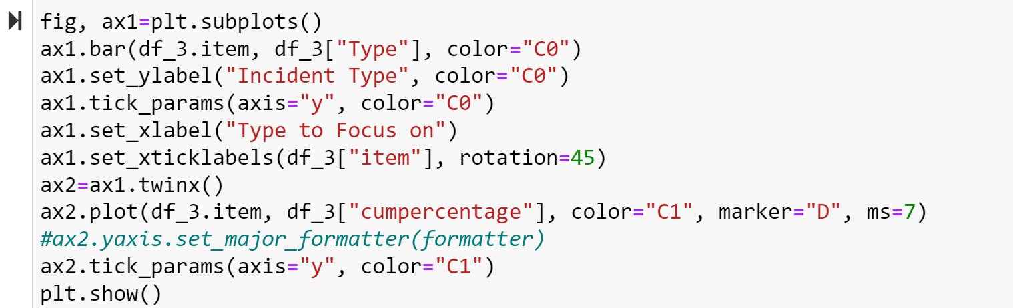
Analytical Distribution: For Analytics Distribution, I will create a pareto chart of variable Type in the dataframe ‘Combined Dataset’
Based on the above Pareto Distribution, Espionage Type is significant and need to be addressed to tackle this Incident Type

Slide 13
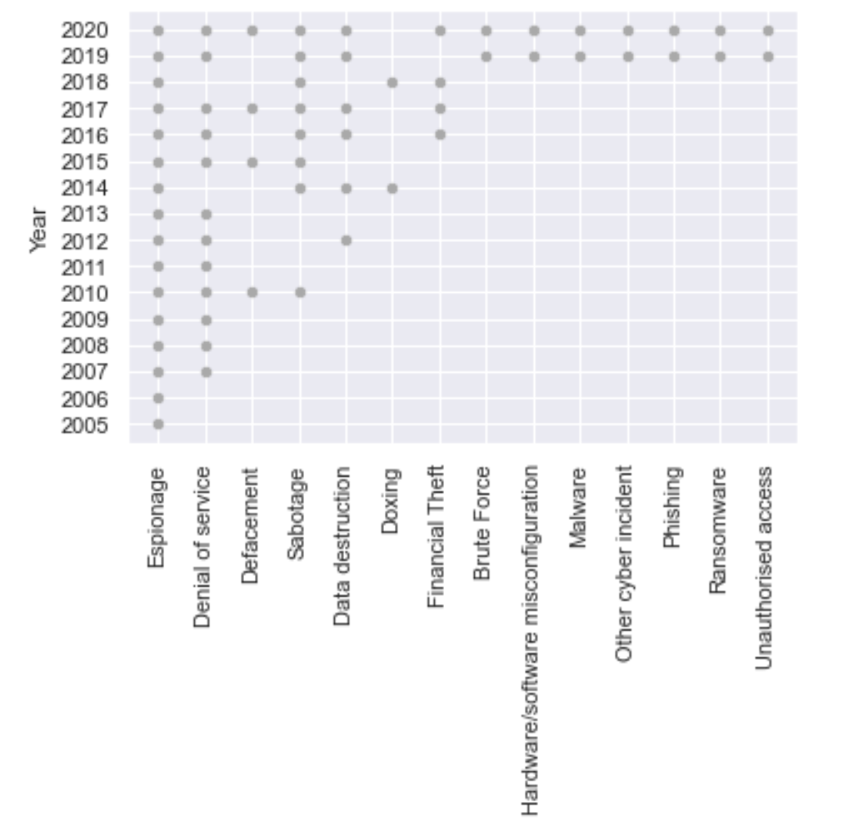
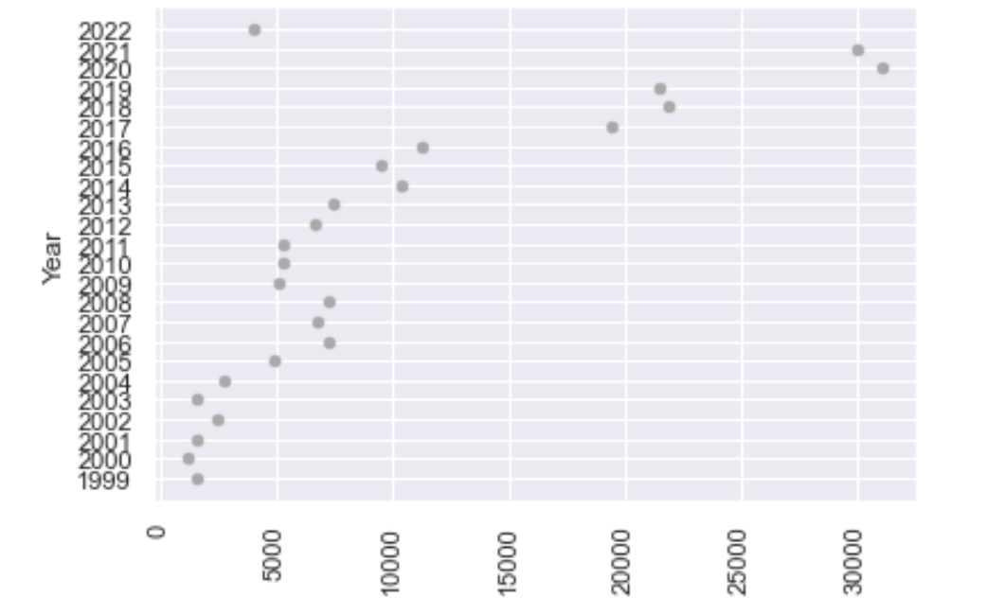
Scatterplots and interpretation for the Combined dataset and the vulnerability dataset
I created scatterplots on a couple of variables of my interest (Year and incidents for the Combined dataset of security incidents and count of vulnerabilities by year for the vulnerability dataset) and both show a linear positive correlation between the variables. When the points in the graph are rising (as in my case in both the datasets I used the scatterplots), moving from left to right, then the scatter plot shows a positive correlation. It means the values of one variable are increasing with respect to another.
Combined Dataset
Vulnerability Dataset

Slide 14
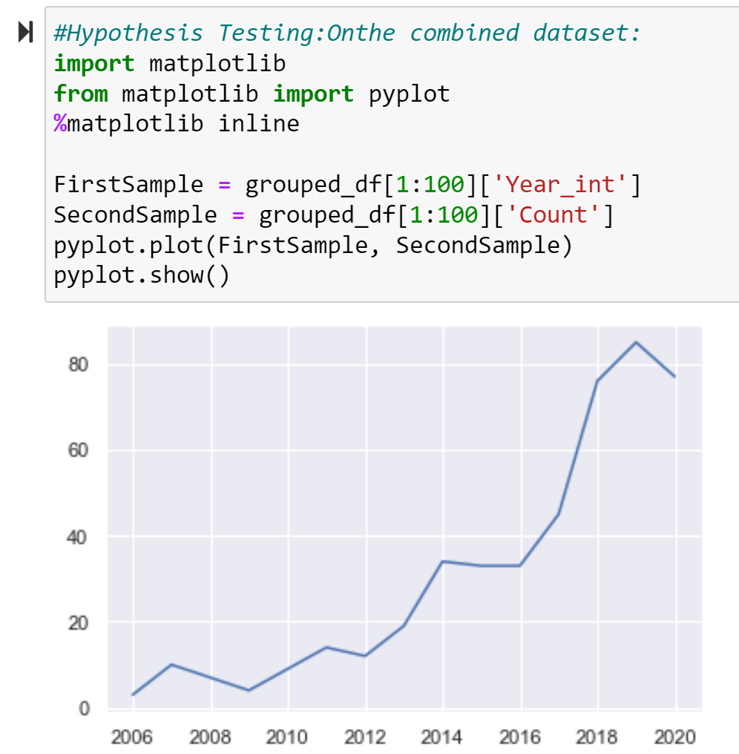
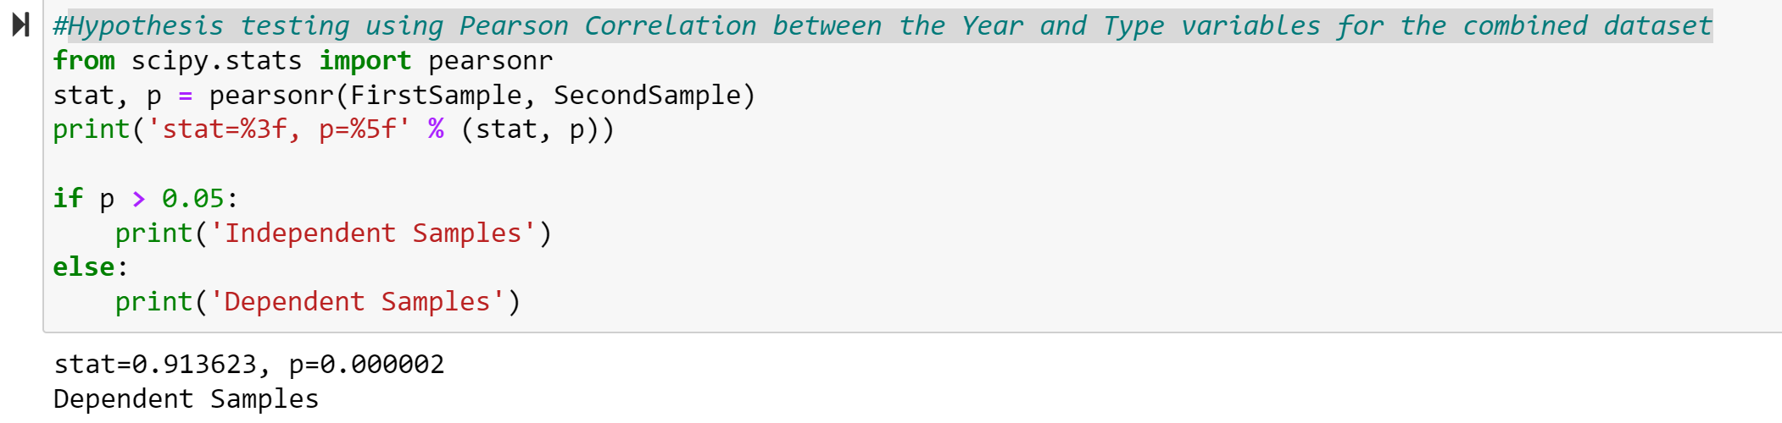
Hypothesis Testing for the Combined dataset
A hypothesis test formally tests if there is correlation/association between two variables in a population. I performed the correlation test between the Year and Type variables to test if Cyber Security Incidents increase as years go by and are therefore correlated. Below shows that in the combined dataset, these two variables are dependent and correlated. I also plotted the sample which also shows linear dependency and correlation.

Slide 15
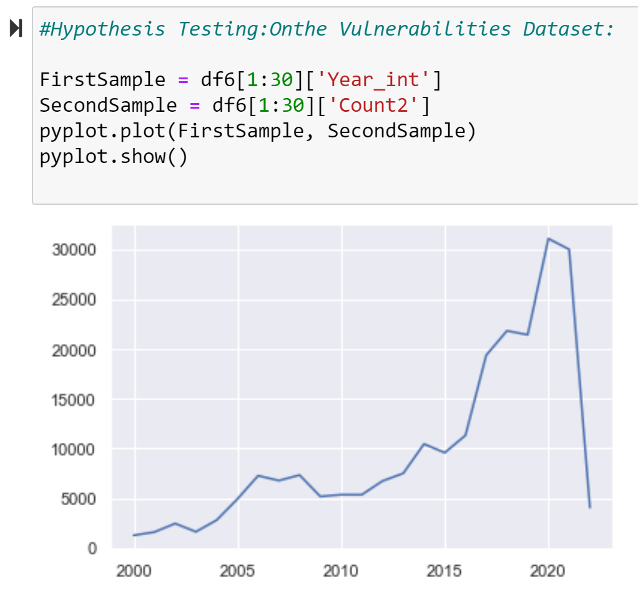
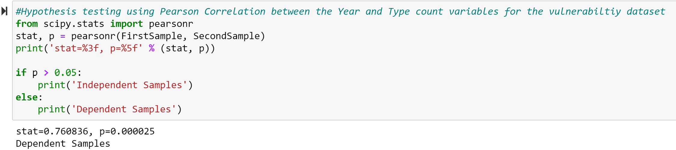
Hypothesis Testing for the Vulnerability dataset
A hypothesis test formally tests if there is correlation/association between two variables in a population. I performed the correlation test between the Year and vulnerability count to test if vulnerabilities increase as years go by and are therefore correlated. Below shows that in the vulnerability dataset, these two variables are dependent and correlated. I also plotted the sample which also shows linear dependency and correlation.

Slide 16
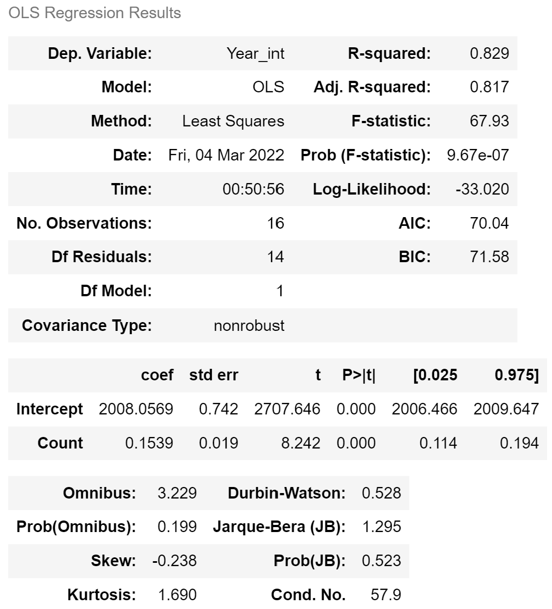
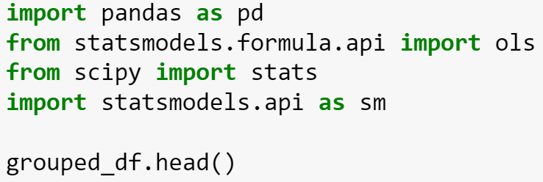

Regression Analysis for the Combined dataset
Regression analysis is commonly used in research to establish that a correlation exists between variables. But correlation is not the same as causation: a relationship between two variables does not mean one causes the other to happen. Regression is 0.829 showing correlation exists.

Slide 17
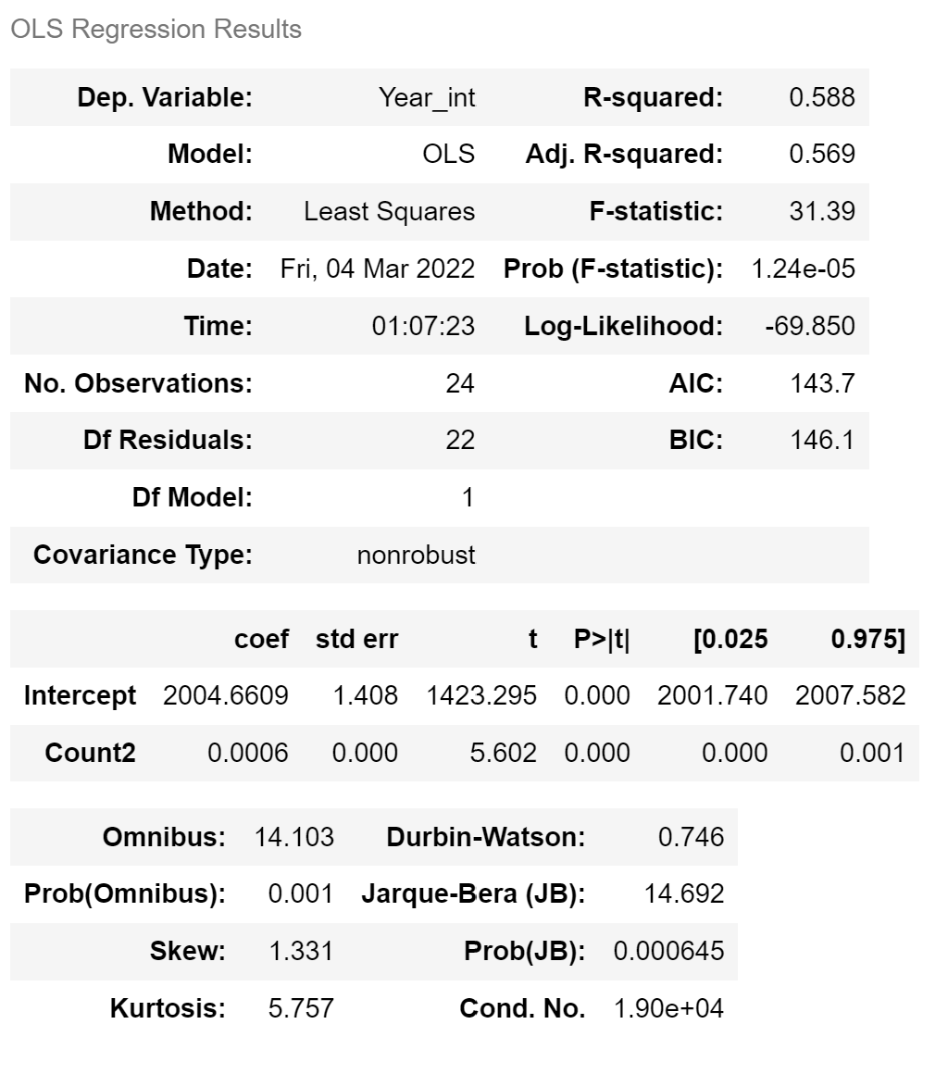
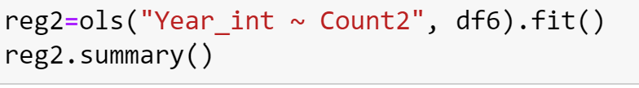
Regression Analysis for the Vulnerability dataset
Regression analysis is commonly used in research to establish that a correlation exists between variables. But correlation is not the same as causation: a relationship between two variables does not mean one causes the other to happen. Regression is 0.588 showing correlation exists.

Slide 18
Conclusion
Based on the analysis performed, we demonstrated that the hypothesis that as we are more dependent on Technology, there are more system vulnerabilities to address and therefore, hackers take advantage of the non-remediated vulnerabilities. More vulnerabilities, more security incidents and breaches. Vulnerabilities and the Security Incidents that take advantage of these vulnerabilities increase over time.
The analysis also showed in probabilities and scatter plots and bar charts that State sponsored (Espionage) is on the rise compared to other types of security incidents. Analytical distribution (Pareto chart) also demonstrated that.
States need to focus on these growing trends and focus on controlling this increasing trend to protect our data assets and possible corporate activity disruption.

